Slide 1
Automatic Brake System using Fuzzy Logic

Slide 2
Overview
Human judgment error may cause serious accidents due to inaccurate reaction time and time consumes to perform full braking. In many such cases, the main cause of such accidents is the distraction through driving and failure to react in such enough time.
Therefore, auto brake system in vehicle will utilize both its speed sensor which measures the wheel speed and distance sensor which is based on ultrasonic waves to compute the safety distance between the vehicle and its neighbours by controlling the brake pressure force on the brake pedal.

Slide 3
In this project, we design human free brake system that maintains both the vehicle speed and inter-vehicle distance, to automatically decelerate the vehicle on urgent demands by controlling the brake force pressure.

Slide 4
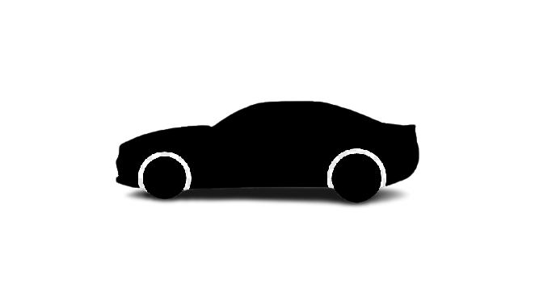
Fuzzy controller-based vehicale
Neighbour vehicale
Distance = d m
Simplified explanation of our proposed fuzzy controller

Slide 5
INPUT-OUTPUT OF FUZZY LOGIC SYSTEM
2 inputs
1 output
the inter-distance is based on ultra-sonic sensor
speed is based on speed sensor
The output of our fuzzy proposed controller is brake force pressure

Slide 6
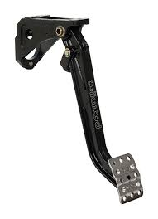
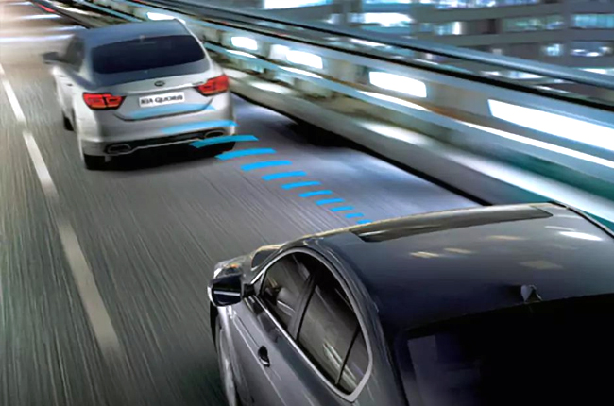
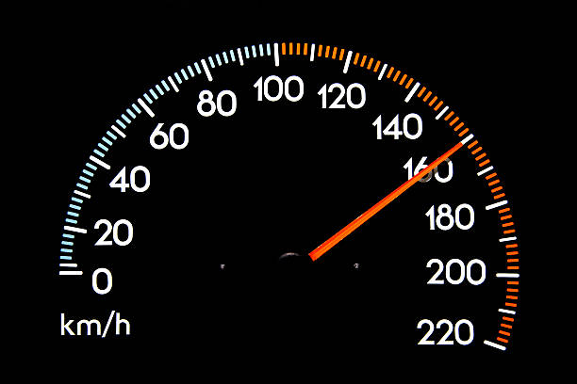
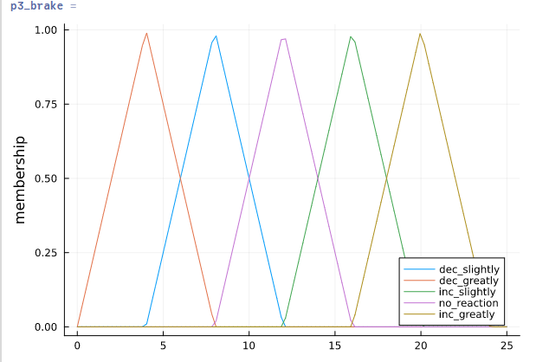
DESIGN STRUCTURE
Inputs :
Output :
DISTANCE
Fuzzy decisions making :
INFERENCE ENGINE
MAMDANI
BRAKE FORCE AMOUNT DEFUZZIFICATION
(CENTROID)
CAR SPEED

Slide 7
Fuzzification
We divide the distance range from 0-10 m to three sub ranges, too close(too close), close, and far.
The inter-vehicle distance is classified as follows:
Very close distance (0-4 m), Triangular.
Close distance (2-8 m), Trapezoidal.
Far distance (6-10 m), Triangular.

Slide 8
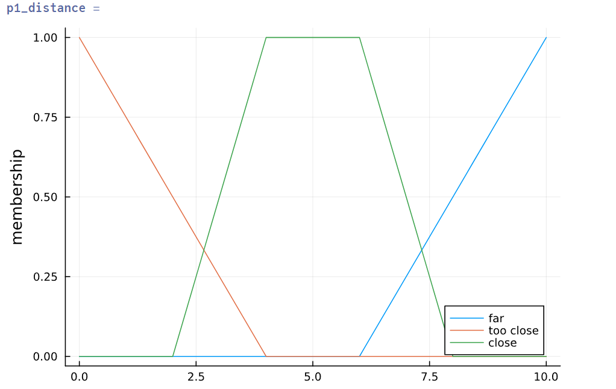
Membership function of inter-vehicale distance

Slide 9
We divide the vehicle speed from 0 to 25 m/s to 5 different ranges as follows:
Too slow (0-4 m/s), Trapezoidal.
Slow (2-9 m/s), Trapezoidal.
Optimum (7-15 m/s), Trapezoidal.
Fast (13-20 m/s), Trapezoidal.
Too Fast (18-25 m/s), Trapezoidal.

Slide 10
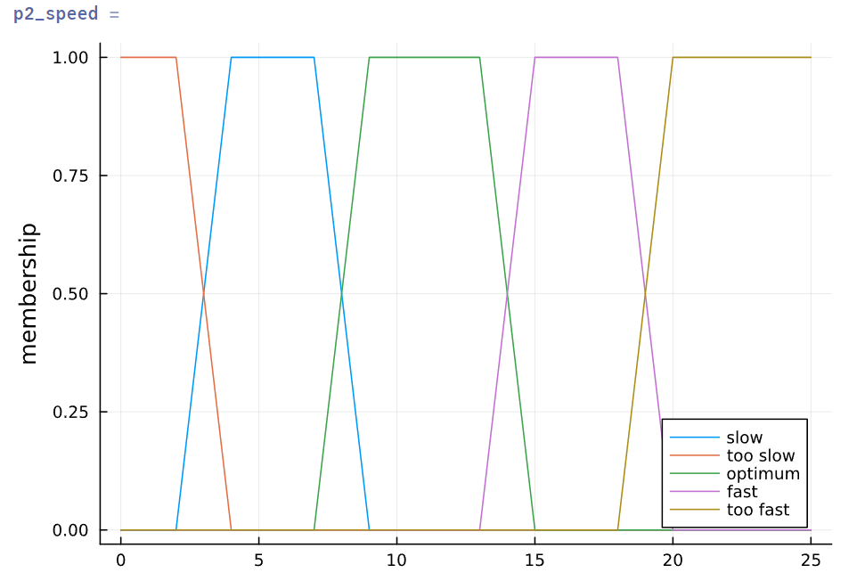
Membership function of speed

Slide 11
The output of our fuzzy system is the amount of brake force and is classified as follows:
Decrease brake force greatly (0-8 N)
Decrease brake force slightly (4-12 N)
No brake reaction (8-16 N)
Increase brake force slightly (12-20 N)
Increase brake force greatly (16 -24 N)

Slide 12
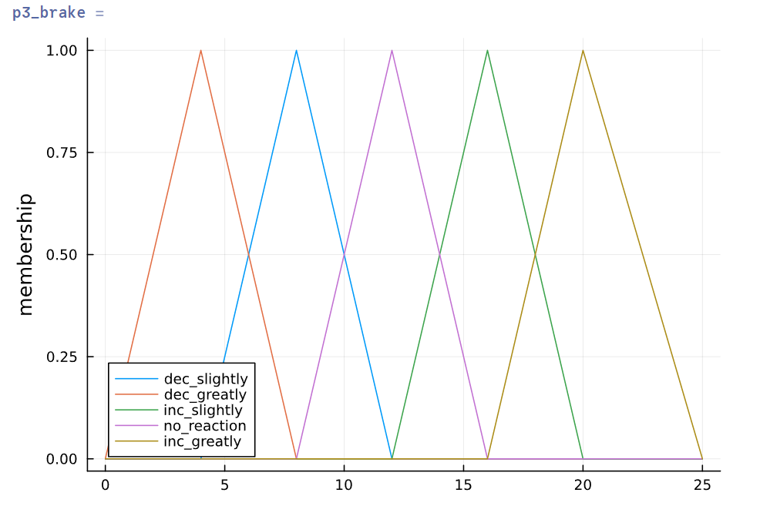
Membership function of brake_force_amount

Slide 13
Rule Base
If |  |  | Then
Too close |  |  |  | Increase greatly
Close | And | Too fast |  | Increase greatly
Close | And | Fast |  | Increase slightly
Close | And | Optimum |  | Increase slightly
Close | And | Slow |  | Increase slightly
Close | And | Too slow |  | No reaction
Far | And | Too fast |  | Increase slightly
Far | And | Fast |  | No reaction
Far | And | Optimum |  | No reaction
Far | And | Slow |  | Decrease slightly
Far | And | Too slow |  | Decrease greatly

Slide 14
Defuzzification
We used Mamadni inference engine which is the simplest one and to extract the crisp output we used a centroid method.

Slide 15
Julia code using Pluto.jl

